Slide 1
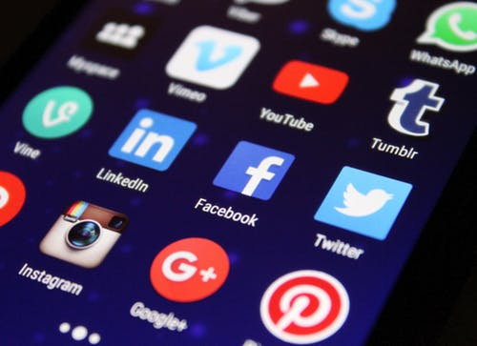
Rejuvenating Your Facebook Presence
Tips to increase your visibility on FB
MFMA Annual Conference December 2020 – Saturday, Dec. 5th, 1:45pm
By: Kim Guenther
Director of Communications
Minnesota Farmers’ Market Association

Slide 2
Rejuvenating your facebook presence
Why FB?
2.7 Billion people use
FB every month

Slide 3
Your personal Facebook knowledge
NOVICE/
ADVANCED BEGINNER
EXPERT/
TRAIL BLAZER
COMPETENT/ PROFICIENT

Slide 4
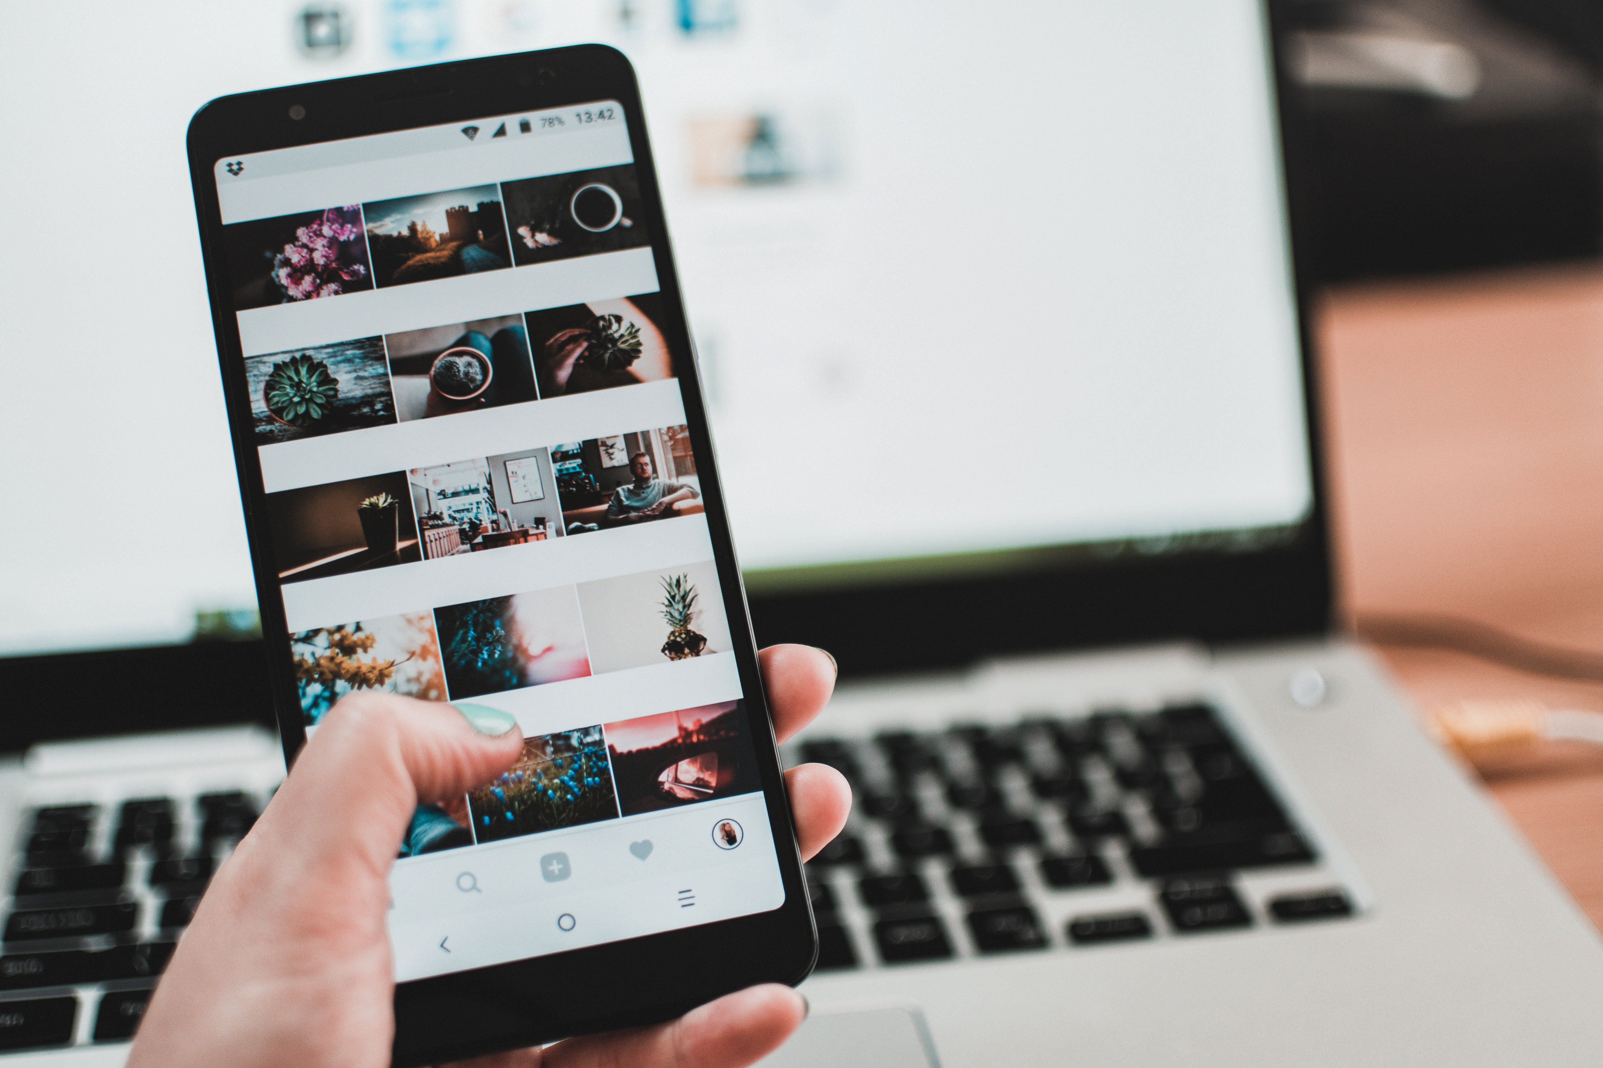
Profiles, Pages, and Groups
Profiles - Generally your personal place on FB where
you share information about yourself, family etc.
Pages - Places on FB where businesses, brands,
organizations, etc. can connect with customers and community.
While profiles and groups can be private, pages are public. You must have a profile to create a page or help manage one
Pages have more features than groups including insights and advertising options.
Groups - A place to communicated about shared interests with people.
Often better at creating real community.

Slide 5
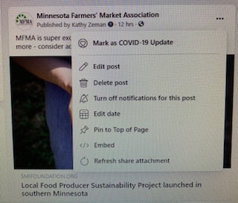
How to grow beyond your friends and family – Ideas for increasing visibility and engaging with your audience
Get clear on your business brand
What do you want to be known for?
Who is it you serve?
What problem do you solve?
Pin Important Facebook Posts to top of your page.
Ellipses – left click – pin to top of page

Slide 6
Visibility and Engagement
Use Facebook to drive traffic to market AND vice versa.
QR codes
Giveaways
FB Challenges
Gift cards
Polls
Q and A Sessions

Slide 7
Visibility and Engagement
FACEBOOK LIVE
Create engagement worthy content
Ask for engagement
Consistency
Keep it short
Highlight what’s in season
Don’t wait for people to hop on
Pre-promote and post –promote
Hop on in facebook stories and tell people you’ll be going live and when
After take a facebook live and start a watch party
Consider a giveaway
Give people a houtout through the facebook live
Consider taking $5 or $10 to boost your live post

Slide 8
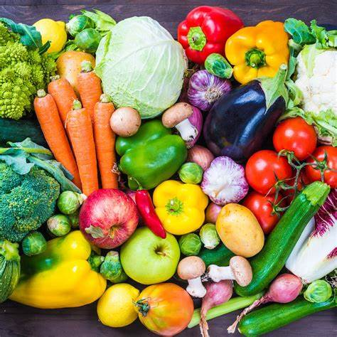
Quick TIPS –
Spotlight your partners
Include visuals – take quality pics
Create consistent weekly content that serves your customers.
Change times that you post (check analytics)
Schedule your posts
Don’t worry about negative comments
Resource:
www.facebook.com/business/

Slide 9
New Facebook Features “The only constant is change”-Heraclitus
There have been LOTS, but here are just a few updates from 2020
Facebook Avatars (mobile)
A new reaction – Care
Facebook live producer – this allows you to enhance your Facebook live. You can add polls, questions, etc.
Audio only-live stream – Kind of like a podcast – they took it away and have now brought it back.
Take a picture and make it a 3-d photo
Facebook Stories - Animate (zoom in or out add stickers)

